Slide 1
Brachial plexus Injury
Dr. Mansoor

Slide 2
Objective
To know the causes of injury, deformities and PT management.
Should be able to list causes, signs and symptoms ,evaluation ,conservative , surgical managements and physiotherapy management of nerve injuries
To set Goal according to Sunderland’s classification and Intervention including splinting and adaptive equipment ,Post-surgical rehabilitation including nerve graft

Slide 3
Brachial plexus is responsible for cutaneous (sensory) and muscular (motor) innervations of the entire upper limb.
5 main nerves arise from brachial plexus:
Axillary nerve
Musculocutaneous nerve
Radial nerve
Median nerve
Ulnar nerve

Slide 4
•Formed by anterior (ventral) rami of C5 to C8, and most of the anterior ramus ofT1.
•Originates from neck, passes laterally and inferiorly over rib I, and enters axilla.
•The part of brachial plexus from medial to laterally are roots, trunks, divisions, and cords.
•Proximal part is posterior to subclavian artery
•Distal part is surrounded by axillary artery.

Slide 5
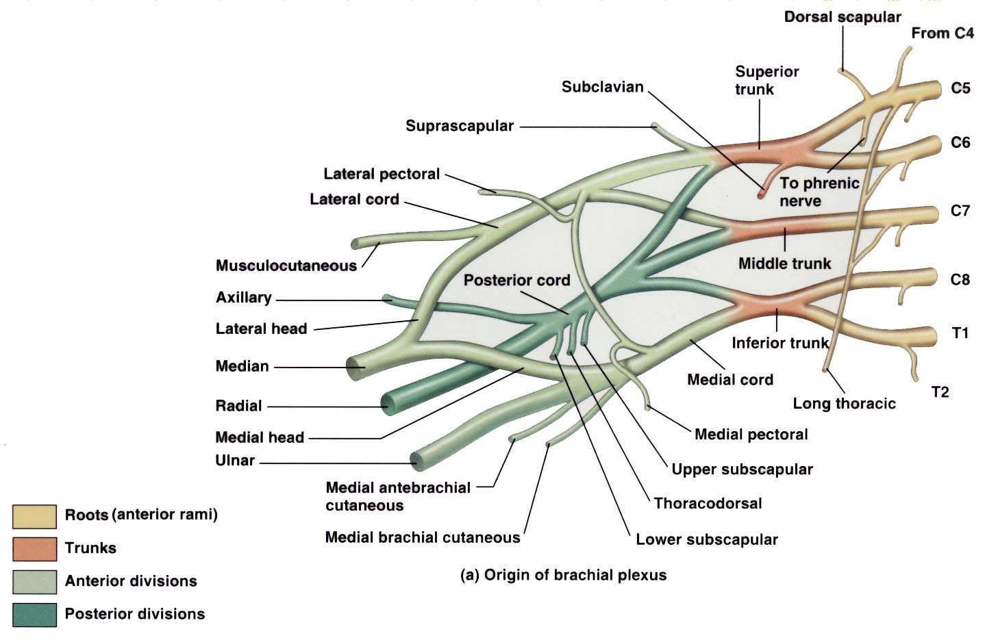

Slide 6
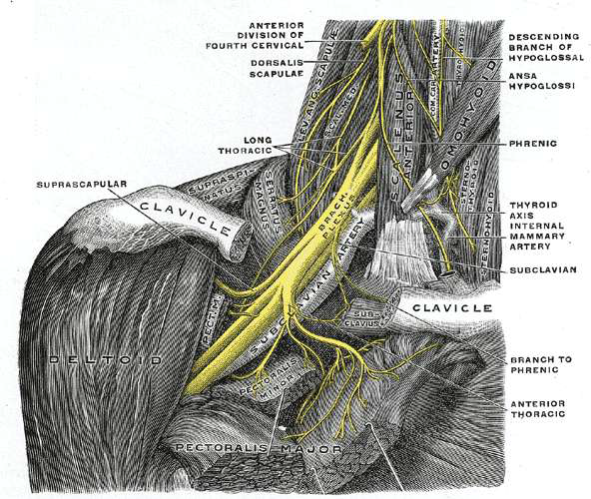

Slide 7
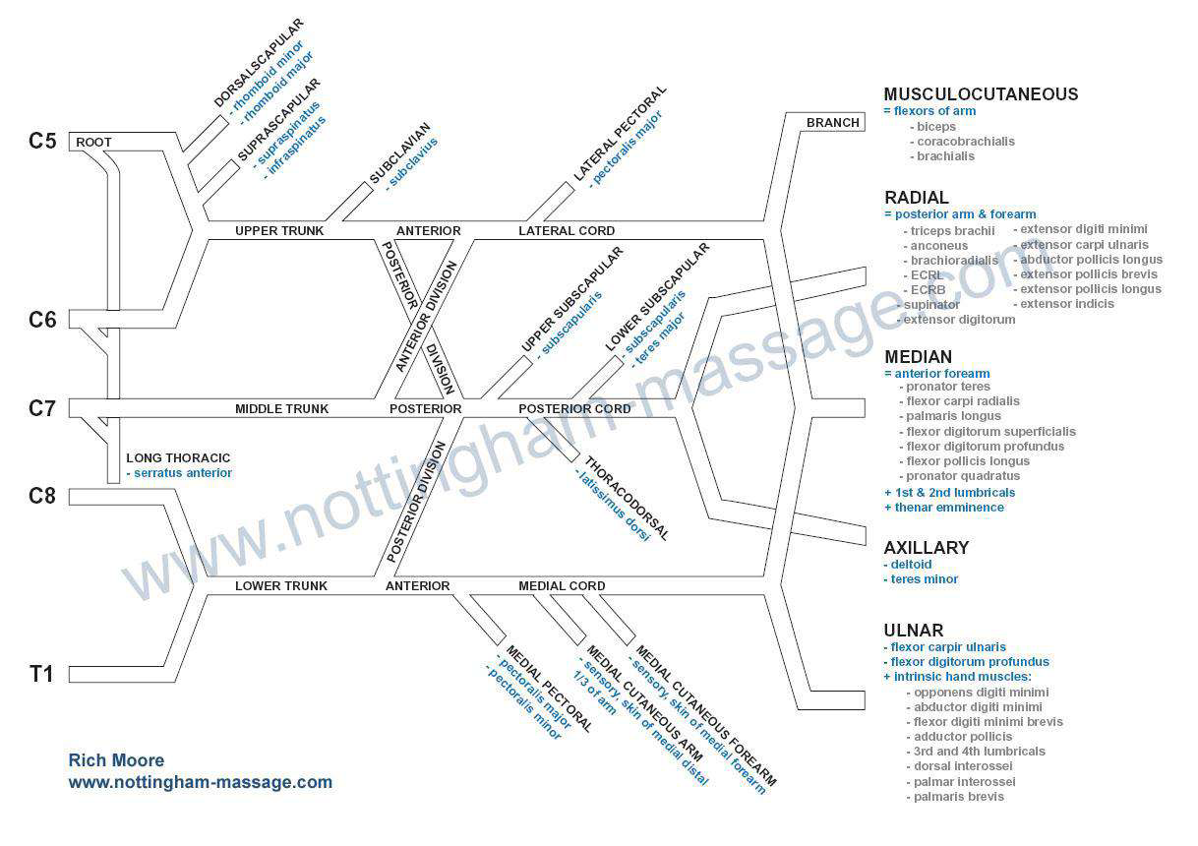

Slide 8
ROOTS
Originates from C5-C8 and most of T1
Root and trunk enter posterior triangle of neck by passing between anterior scalene and middle scalene muscles and lies between superior and posterior to subclavian artery.

Slide 9
TRUNKS
C5,C6 roots pass down wards between scalenus medius and scalenus anterior muscles and unite to form SUPERIOR TRUNK.
C7 root pass between scalenus muscles and at lateral border of scalenus anterior emerges as MIDDLE TRUNK.
C8, T1 roots unite behind a fascial sheet and beneath the subclavian artery form LOWER TRUNK.

Slide 10
DIVISION
Lateral to the 1st rib , where three trunks are located behind the axillary artery ,they separate into 3 anterior and 3 posterior divisions
The 3 anterior division form parts of brachial plexus that ultimately give rise to peripheral nerves associated with the anterior compartment of arm or forearm.
The 3 posterior division combine to form parts of the brachial plexus that give rise to nerves associated with the posterior compartments.

Slide 11
CORDS
3 posterior divisions unite to form posterior cord
Anterior divisions of upper and ,middle trunks
(C5-C7) unite to form lateral cord
Anterior division of lower trunk forms medial
cord(C8-T1)

Slide 12
BRANCHES OF ROOTS
Dorsal scapular nerve-(c5)- levator scapulae, rhomboids (MAJOR-MINOR)
Subclavian nerve(c5-c6)- subclavian muscle
Long thoracic nerve(c5-c7)- serratus anterior muscle.
Lateral anterior thoracic nerve(c5-c7)
Anterior thoracic nerves(c5-T1) supplies pectoralis major, pectoralis minor
Medial anterior thoracic nerve(c8-T1)

Slide 14
Lateral cord
1)Musculocutaneous nerve(c5-c7)
FUNCTION: sensory for skin on lateral side of forearm
2)Lateral head of median nerve(c5-c7)
FUNCTION: motor nerve for ,Pectoralis major

Slide 15
MEDIAL CORD
1)Med. Ant thoracic nerve(c8-T1):Pectoralis major and minor
2)Med. Cut. Nerve of arm(c8-T1): Skin on medial side of distal one-third of arm
3)Med.cut. Nerve of forearm(c8-T1):Skin of medial side of forearm
4) Ulnar nerve(c7-T1):supply all
intrinsic muscle of hand(except thenar muscles and 2 lateral lumbricals),
carpi ulnaris and
median half of flexor digitorum profundus in forearm.
5)Med. Head of median nerve(c8-T1)

Slide 16
POSTERIOR CORD
1)Subscapular nerve(upper, lower)(c5-c7)
2)Thoracodorsal nerve(c5-c7)
3) Axillary nerve(c5-c6)
4)Radial nerve(c5-c8)

Slide 17
List of injury
Upper limb
Brachial plexus palsy
Thoracic outlet syndrome,
Phrenic & intercostals nerve lesions
Median nerve palsy
Ulnar nerve palsy
Radial nerve palsy
Musculocutaneous nerve palsy
Anterior & Posterior interosseous nerve palsy
Axillary nerve palsy
Long thoracic nerve palsy
Suprascapular nerve palsy
Lower limb
Lumbosacral plexus
Sciatic nerve palsy
Tibial nerve palsy
Common peroneal nerve
Femoral nerve palsy
Obturator nerve palsy
Pudendal nerve palsy.

Slide 18
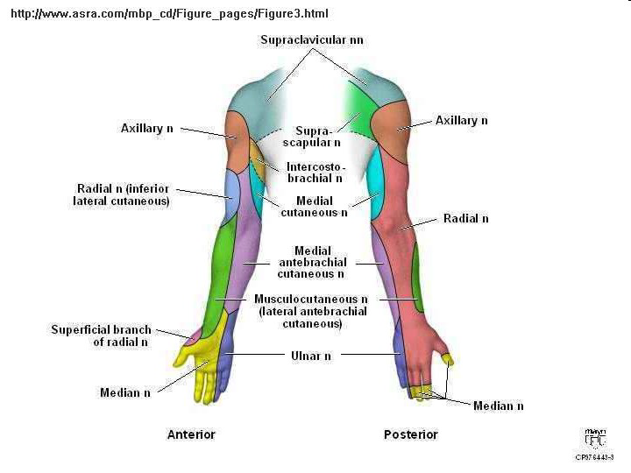

Slide 19
Brachial plexus palsy-Total plexus palsy
Usually due to severe trauma
Entire arm is paralysed
All arm”s musculature may undergo rapid atrophy
Complete anesthesia of arm distal to a line extending obliquely from tip of shoulder to medial arm half way to elbow.
Entire upper limb is areflexia.

Slide 20
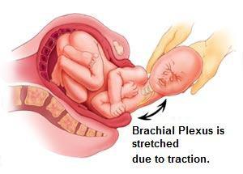
Brachial Plexus Injury- Obstetric brachial plexus palsy
Injury to all or portion of a child brachial plexus occurring at that time of the delivery.
Excessive lateral traction on the head so that the head is pulled away from the shoulder.
Divide into :
Erb’s Duchenne Palsy
Klumpke's Palsy

Slide 21
Upper plexus paralysis
Erb –duchenne palsy results from the damage to c5,c6 roots/upper trunk
Causes- forceful separation of head and shoulder
pressure on shoulder
birth injury
idiopathic plexitis
Paralysis - deltoid, biceps, brachioradialis, brachialis, and occasionally supraspinatus, infraspinatus and subscapularis
Very proximal lesions can cause weakness of rhomboids, levator scapulae, serratus anterior, and scalene muscles
Sensation is usually intact, some sensory loss may occur over the outer surface of upper arm
Reflexes- Biceps, brachioradialis reflexes are depressed or absent

Slide 22
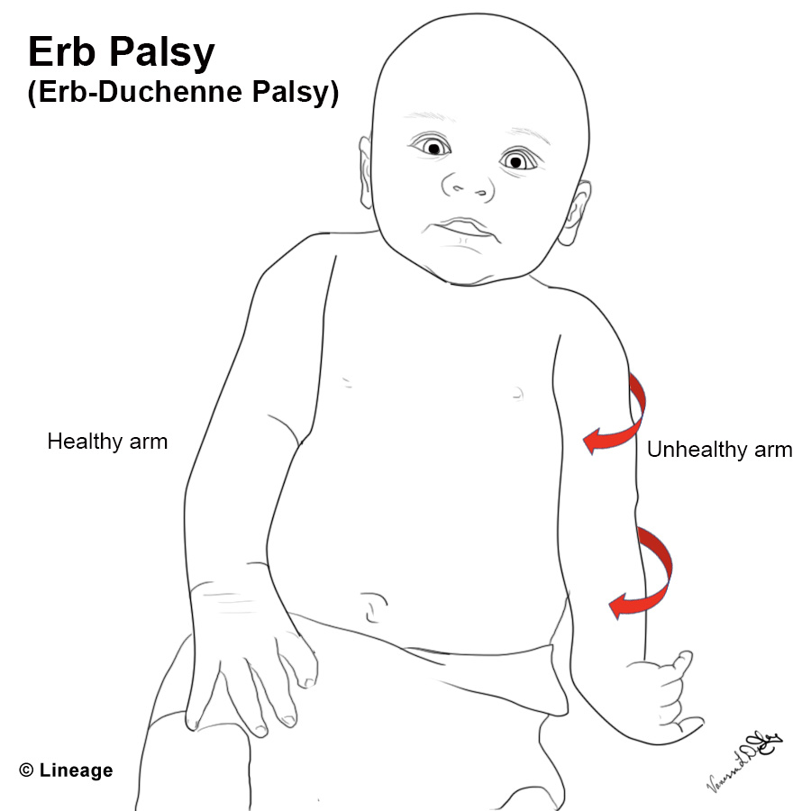
Erb’s Duchenne Palsy
This posture occurs because of paralysis and atrophy of:
Deltoid
Biceps brachii
Brachialis
Involving upper roots (C5, C6 and C7)
Affecting the musculature of the upper arm
Limb is internally rotated, adducted

Slide 23
The elbow is extended (paralyzed C5, C6)
Forearm is pronated
Wrist and digits are flexed
palm facing out and backward-police man’s tip position
Shows the “waiter tips” posture of the paralyze limb.

Slide 24
Lower plexus paralysis
Dejerine-klumpke -follows injury to C8,T1 roots
Causes-trauma
arm traction in abducted position
surgical procedures for lung tumor
Mass lesion like aneurysm of aortic arch
Muscles- Weakness of wrist flexion, finger flexion, and intrinsic muscles of hand resulting in claw hand deformity
Sensation -may be lost in medial arm ,medial forearm ulnar aspect of hand
Reflex- Finger flexor reflex is lost/depressed(C8-T1)

Slide 25
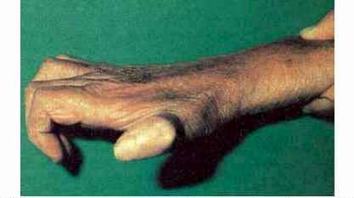
Klumpke’s Palsy
Rare
Involving lower root (C8 and T1)
Affecting forearm and hand
Characterized by paralysis and atrophy of the small hand muscles and flexor of the wrist.
Claw hand

Slide 26
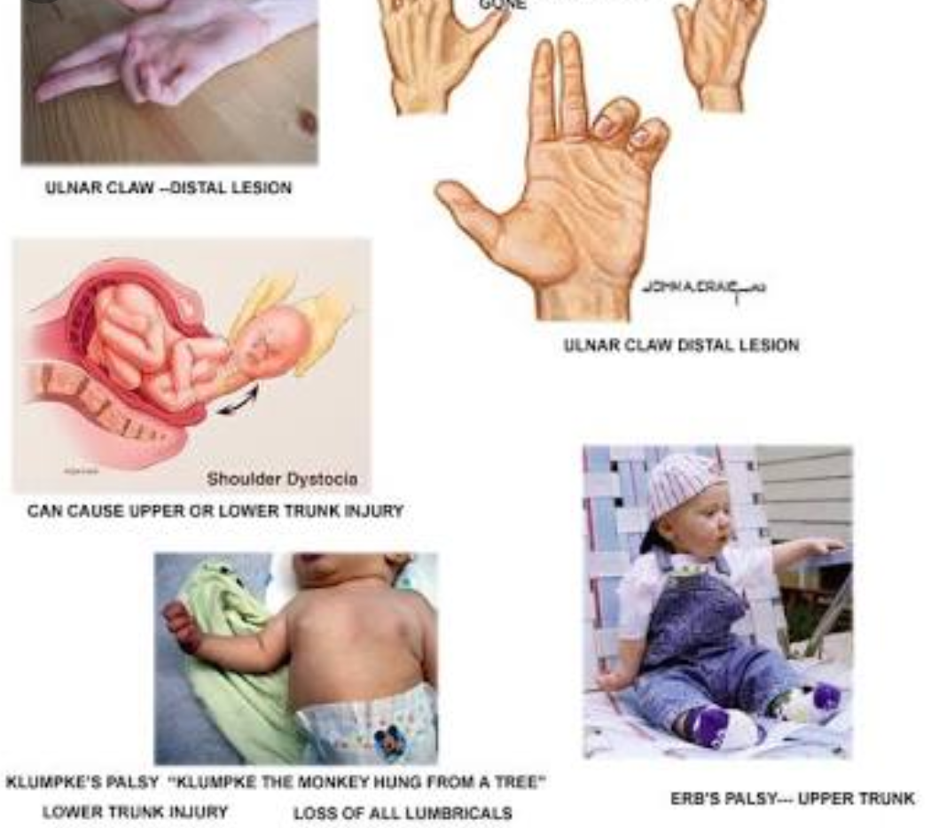

Slide 27
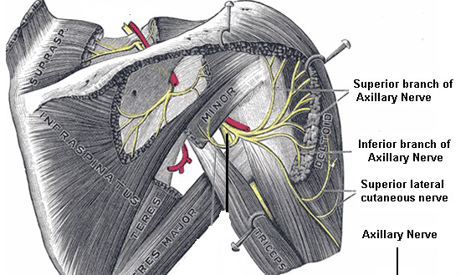
  Axillary Nerves
    Anterior branch (upper branch)
      deltoid muscles (anterior and lateral fiber)
    Posterior branch (lower branch)
      teres minor
      posterior part of the deltoid (posterior fiber).
      superior lateral cutaneous nerve of arm
(shoulder joint and skin)

Slide 28
Axillary Nerve Palsy
Cause –
shoulder dislocation
Trauma causing damage to myelin sheath
Sports-hockey ,boxing
Surgery-anterior shoulder operation
Crutch pressure injury
Pressure from cast or splint
Deep infections
Symptom-
Weak deltoid and sensory loss below shoulder
Cannot bend arm at the elbow
Unable to raise arm of shoulder

Slide 29
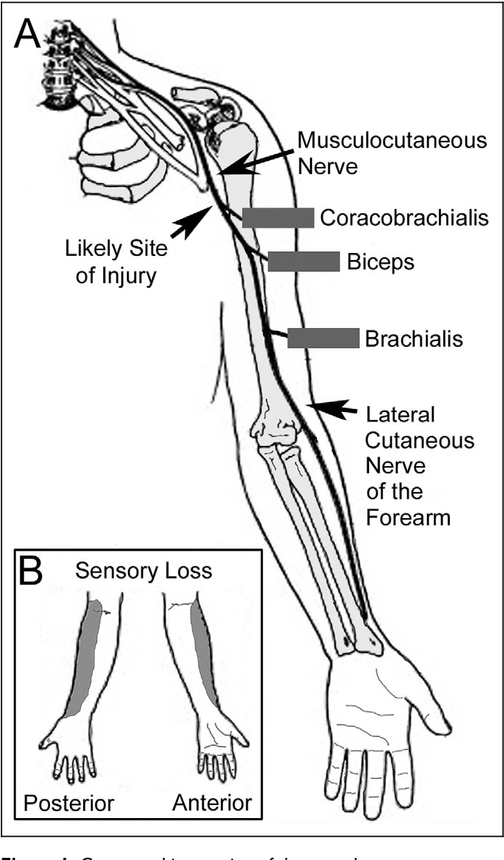
Musculocutaneous Nerve
Arise from lateral cord of brachial plexus
Arise from root C5, C6 and C7.
Muscles - coracobrachialis
-biceps brachii
- brachialis to the lateral
side of the arm.
Then continue in the forearm as the
lateral antebrachial cutaneous nerve.
Anterior branch Posterior branch
skin of antero lateral surface of forearm as far as ball of the thumb
skin of posterolateral surface of forearm.

Slide 30
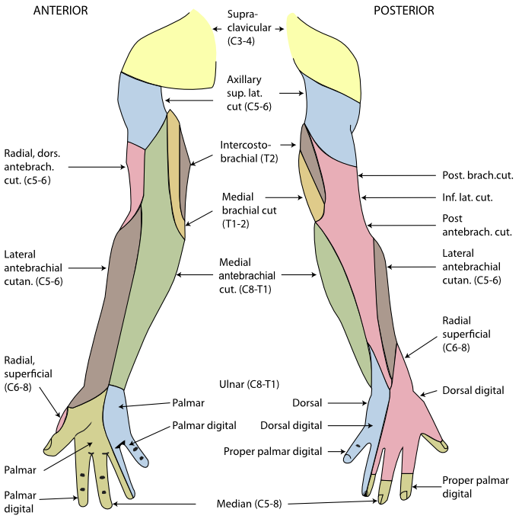

Slide 31
Causes-
Entrapment between biceps aponeurosis and brachialis fascia
Stretch during throwing
Dislocation
Surgery
Heavy backpack
Weight lifting
Muscles-weakness of elbow flexion and supination of forearm

Slide 32
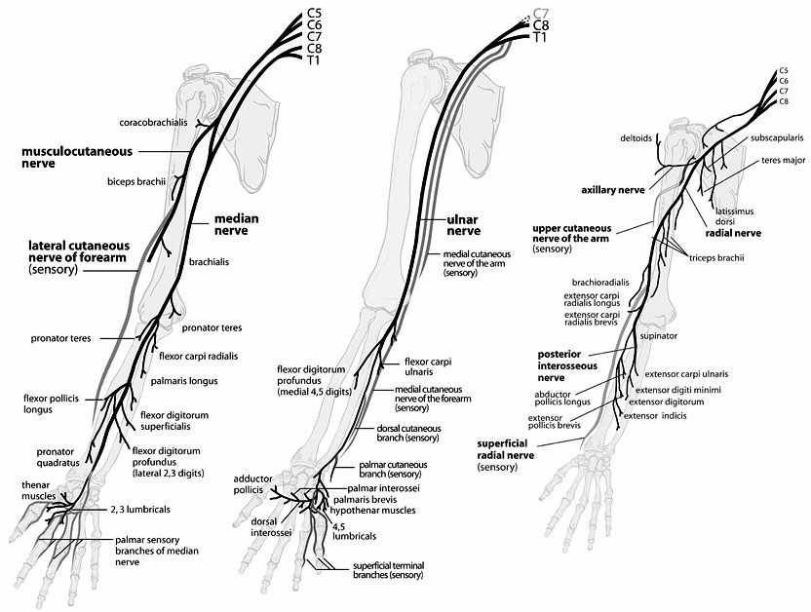

Slide 33
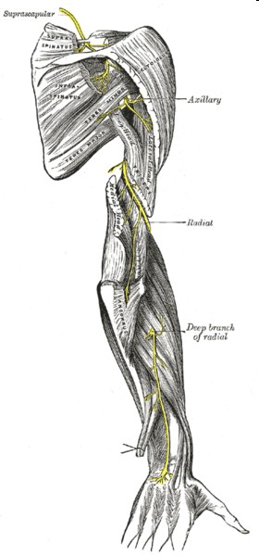
Radial Nerve
Arise from posterior cord of brachial plexus
Arise from root C5, C6,C7, C8 & T1.
It descends obliquely through the arm,first in
posterior compartment of the arm, later
anterior compartment of the arm, and continues
in the posterior compartment of the forearm.

Slide 34
Radial nerve will innervate triceps brachii.
Radial nerve then enter the radial groove.
Radial nerve emerge from radial groove and enter the anterior compartment of the arm.
It continue the journey between brachialis and brachioradialis.
When the radial nerve reaches the distal part of the humerus, it passes anterior to the lateral epicondyle and continue to the forearm.

Slide 35
In the forearm, it will branch of to superficial branch
(mainly sensory) and deep branch (mainly motor).
Cutaneous innervation -provides sensory innervations for much of the skin on the back of the arm.
Motor innervations
Triceps brachii
anconeus
Brachioradialis
supinator
posterior compartment extrinsic hand muscles.

Slide 36
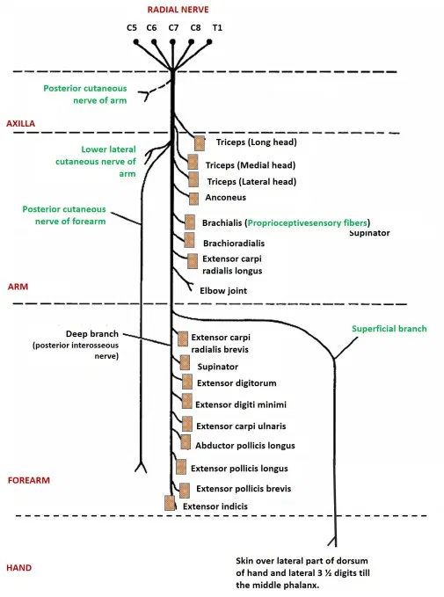
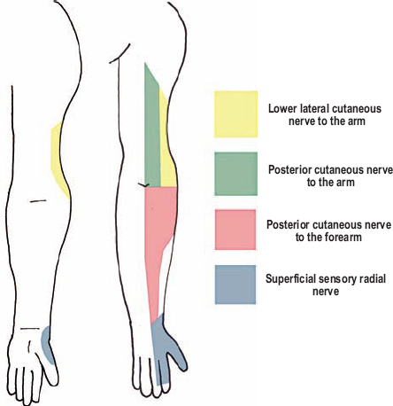

Slide 37
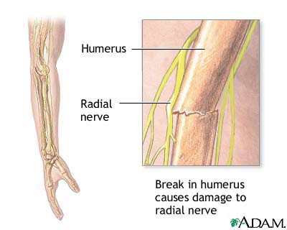
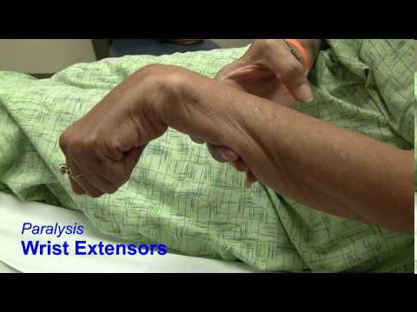
Injury
close to the humerus,
fracture
pressure from direct blow
to the humerus (incorrect use of a crutch)
total paralysis of the extensor of the wrist and digits leads to the dropped wrist deformities.

Slide 38
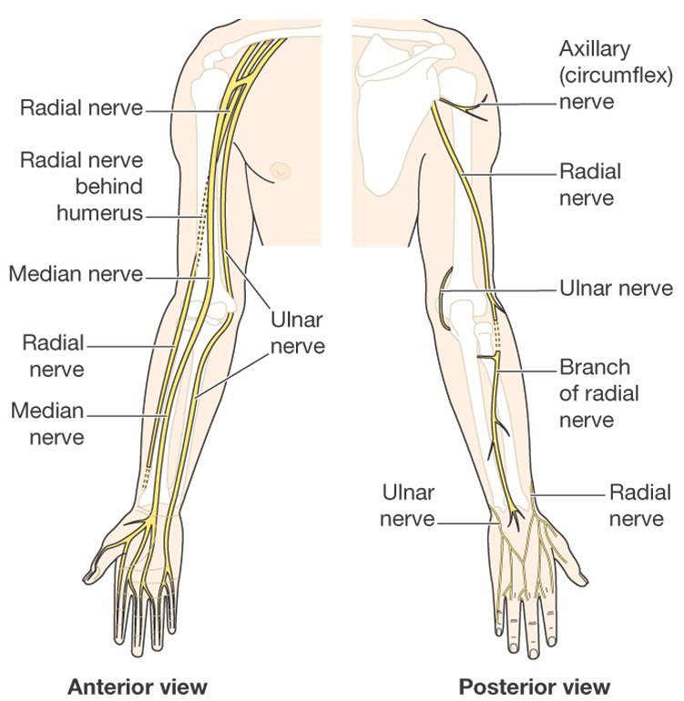
Ulnar Nerve
Arise from medial cord of brachial plexus.
Root C8 and T1 (mostly C7)
Descend on the postero-medial of the humerus.
Then it goes posterior to the medial epicondyle.

Slide 39
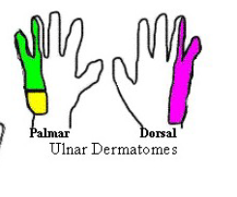
Enter anterior compartment muscles of forearm and supplies flexor carpi ulnaris and medial half flexor digitorum profundus.
Then ulnar nerve enter palm of the hand and branch off
superficial branch
deep branch
palmaris brevis
skin anterior and posterior of the hand (medial aspect of the hand/ one an half digits)
hypothenar muscles
intermediate hand muscles

Slide 40
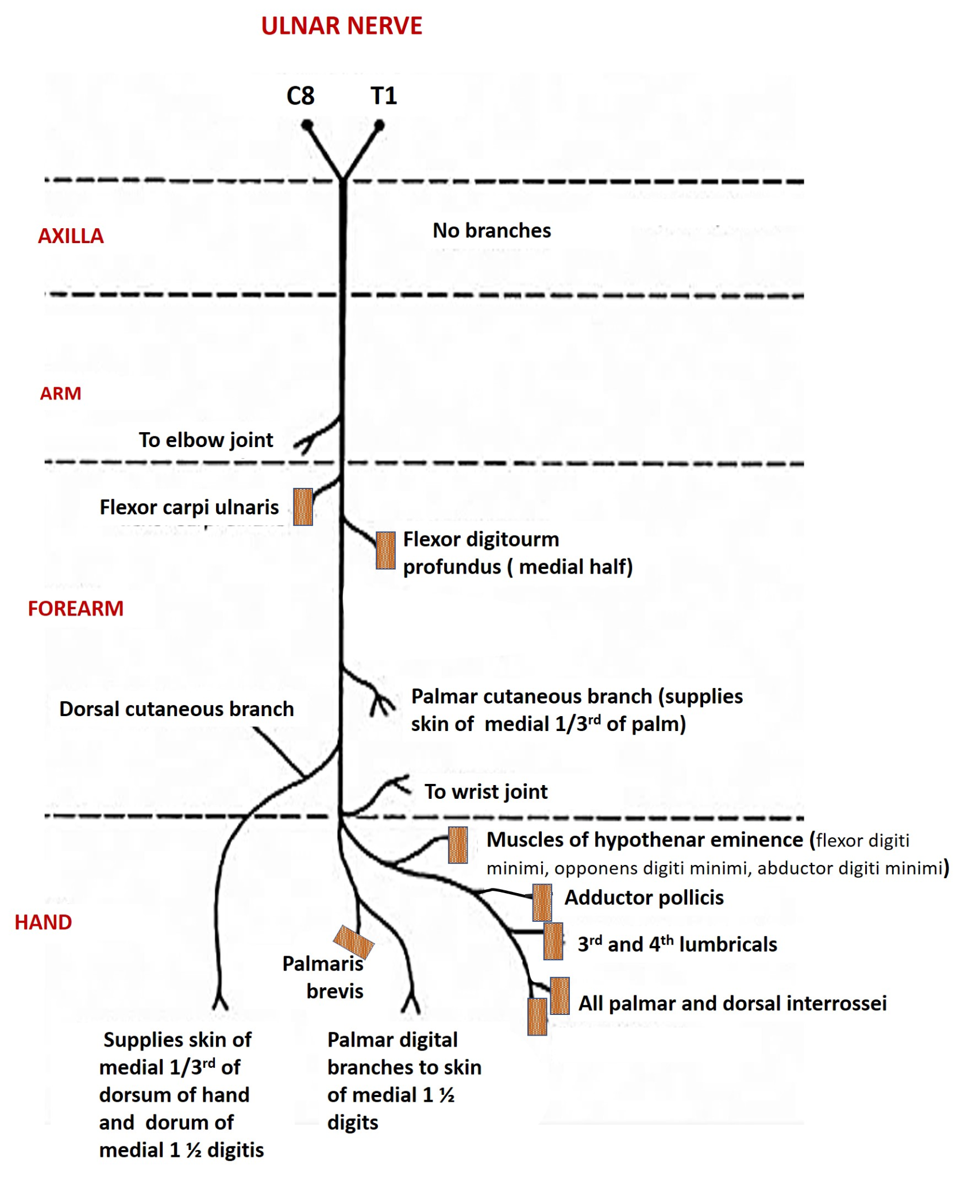
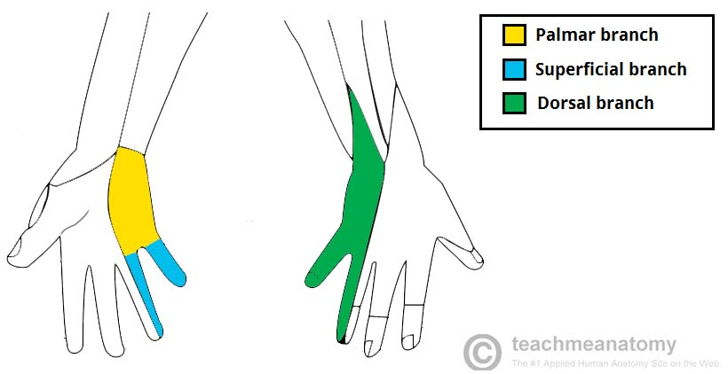

Slide 41
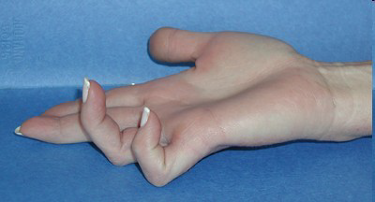
Claw hand deformities
The results of the ulnar nerve lesion leads to the typical ‘claw hand’ deformities.
Leads to partial or completely lost of muscular and sensory innervations.

Slide 42
Causes-
damaged in the groove behind the medial epicondyle by trauma
Entrapment
Fracture
Muscles-intrinsic hand muscles and unopposed actions of antagonistic muscles group.
Wasting of hypothenar eminence.
There are ‘guttering between metacarpals, inability to abduct the fingers or adduct the thumb.
Sensory loss

Slide 43
Median Nerve
Arise from lateral root of lateral cord (C5,6,7) and medial root and medial cord (C8,T1) of brachial plexus.
Passes down the midline of the arm in close association with the brachial artery.
Passes in front of elbow joint (cubital fossa) then down to supply the muscles of the anterior of forearm.
Then it continue into the hand through carpal tunnel where it supply intrinsic hand muscles and skin of forearm.

Slide 44
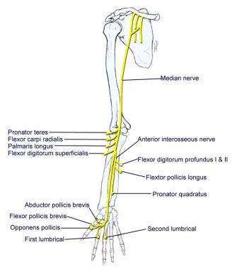
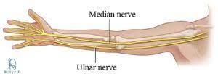
At the cubital fossa the anterior interosseous nerve
arises from the median nerve
Descend through the forearm and end at the wrist by giving the articular branch to the radiocarpal and intercarpal joint.

Slide 45
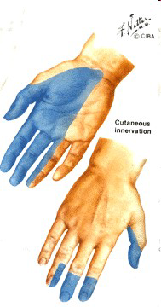
Motor –
all anterior (flexor) compartment of forearm
half of the flexor digitorum profundus
Pronator teres & quadratus
intrinsic hand muscles
(LOAF-1,2 lumbricals, OP,AbPB, FPB,)
Sensory –
skin of the palmar aspect of the thumb
lateral 2 ½ fingers
distal ends of the same fingers
skin of distal phalanx on same finger

Slide 46
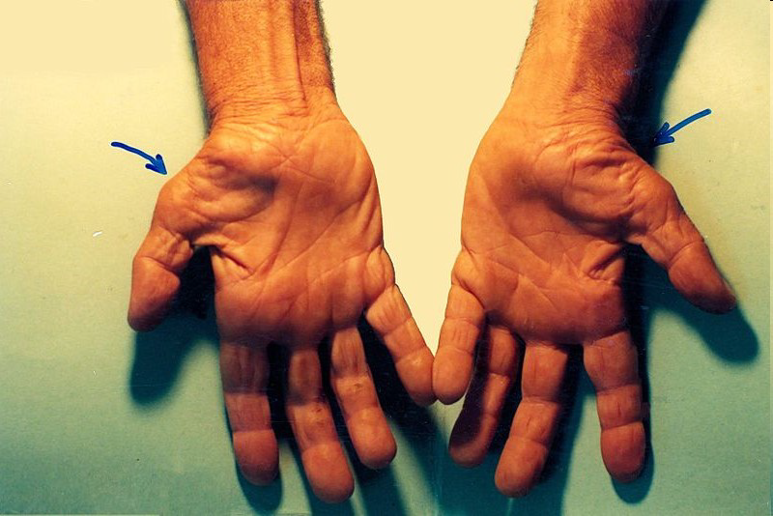
Carpal tunnel syndrome (CTS)
Causes-
deep cut
Compression
Motor-lost of flexion at all IP joint except the distal ones in the ring and little finger
MCP still can be flexed at this fingers ( lumbricals)
In the hand thumb is extend and adducted,
lost of ability to abduct and oppose.
Symptoms- Patient will experience numbness, tingling, or burning sensation at the thumb, index, middle and radial half of the ring finger.
Muscles– weakness or atrophy of the thenar muscles.

Slide 47
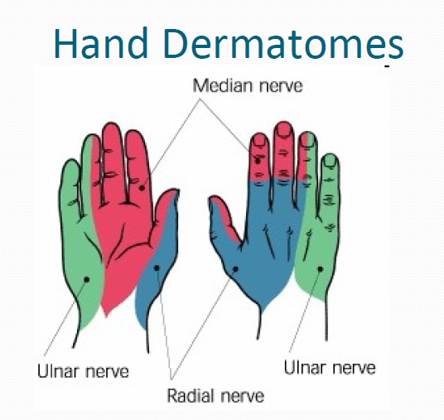

Slide 48
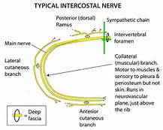
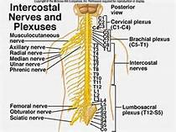
Intercostal nerve
Arise from anterior rami of the thoracic spinal nerves from T1 to T11 .
They are distributed to thoracic pleura and abdominal peritoneum.

Slide 49
The first two-upper limb (1st rib, brachial plexus )
Next four- walls of thorax
Lower five – wall of thorax & abdomen
  7th-xyphoid process
  10th - navel
  12th – abdominal wall & groin

Slide 50
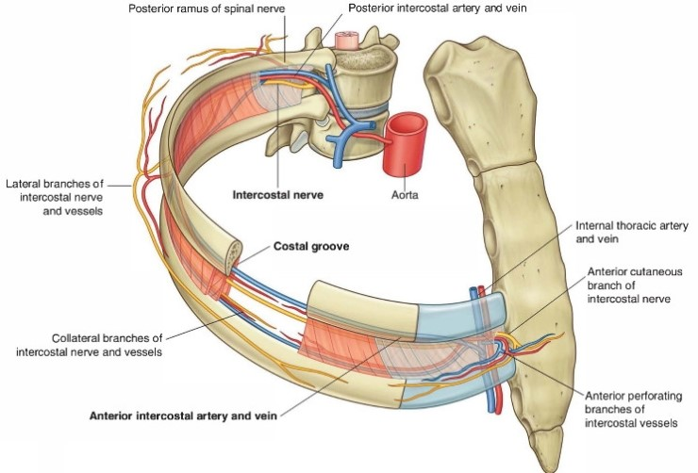
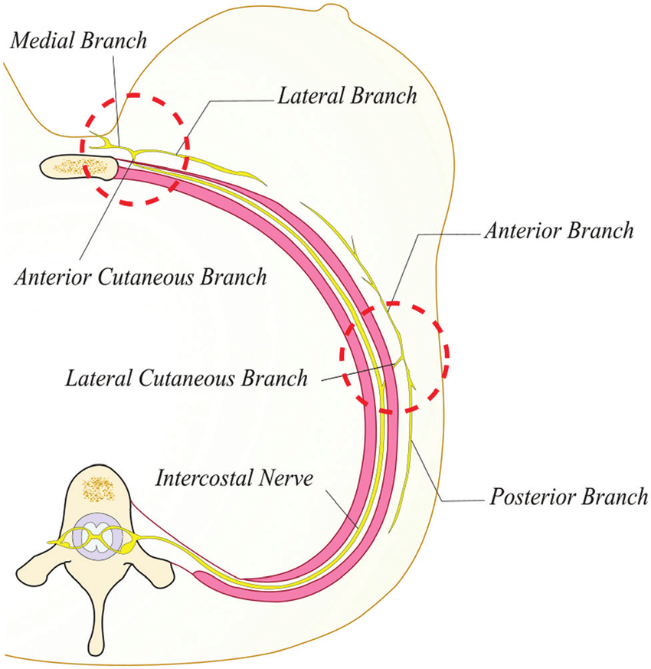

Slide 51
Intercostal nerve lesion
Neuralgia is commonly seen where there is irritation to intercostal nerves
Causes –
Inflammation
Damage or compression
PTPS-Post thoracotomy
Scar
Tumour

Slide 52
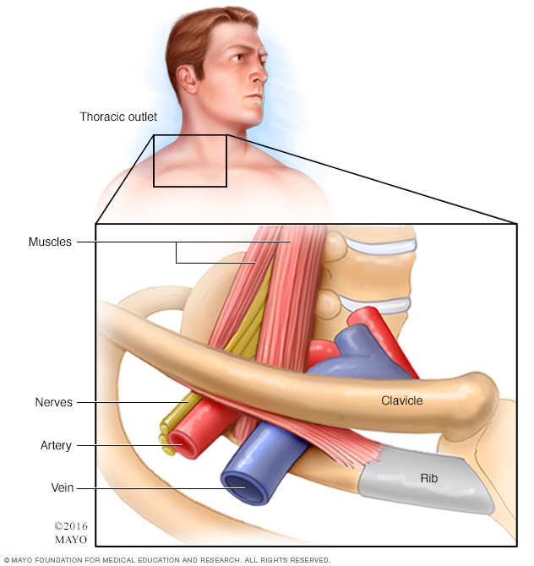
Symptoms-
Pain wraps around chest
Upper abdomen
Burning, spasm
stabbing
Sudden movements
increases pain

Slide 53
Phrenic nerve
The phrenic nerve originates mainly from the 4th cervical nerve, but also receives contributions from the 3rd and 5th cervical nerves (C3-C5) .
Phrenic nerve receives innervation from parts of both the cervical plexus and the brachial plexus of nerves.

Slide 54
Motor fibers - Diaphragm
Sensory fibers -
  fibrous pericardium
  mediastinal pleura
  diaphragmatic peritoneum
  diaphragm (except the most peripheral diaphragm, which is supplied by intercostal nerves)

Slide 55
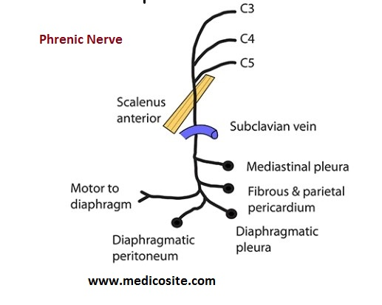

Slide 56
Nerve | Deformity | Muscle
Brachial plexus Upper plexus –C5,C Lower plexus –C8 T1 | Erbs palsy –IR/Add-Police man tip Klumpkes palsy- claw hand | Biceps, brachioradialis Small hand muscle, flexor of wrist
Median nerve palsy | Carpal tunnel syndrome | Thenar muscles
Ulnar nerve palsy | Claw hand 4th& 5th | Hypothenar, intrensic muscles
Radial nerve palsy | Wrist drop | Extensor total fingers musculature
Axillary nerve palsy | Arm rise absent -adduction | Deltoid weakness
Musculocutaneous nerve | Pronation and extension | Weakness of elbow flexion and supination
Suprascapular nerve palsy | Depression of scapula | Scapular muscles
Thoracic outlet syndrome
Phrenic & intercostals nerve lesions | T1-T11 breathing difficulty | Intercostal nerves /diaphragm

Slide 57
Diagnosis of Peripheral nerve injuries
History
Which nerve ?
What level ?
What is the cause ?
What degree of injury ?
Old or fresh injury ?

Slide 58
1. Motor:
All muscles distal to the injury – paralyzed & atonic
Atrophy : 50 -70 % in 1st two months
Striations & motor end plate configurations retained for 12 – 18 months (critical limit of delay)
2. Sensory :
Sensory loss usually follows a definite anatomical pattern, although factor of overlap from adjacent nerves may be present.
Tinel’s sign

Slide 59
(3) Reflex
Abolishes all reflexes transmitted by that nerve, either afferent or efferent arc.
Complete & incomplete lesion. So , not a reliable guide to injury severity.
Deep tendon jerk should be tested for musculocutaneous involvement.
(4) Autonomic :
Loss of sweating
Loss of pilomotor response and
Vasomotor paralysis in autonomous zone

Slide 60
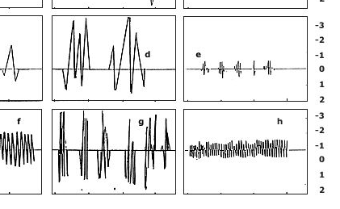
Types of sweat testing
The Q test- (chamber) windows based graphical user –sweat volume & rate.
Ninhydrin test-powder sprayed
Galvanic skin resistance test-decr skin resisitance -current
(5) Investigations
SDC
Normal response-wallerian degeneration
EMG-neurogenic presentation
NCV-decrease conduction velocity
F latency-confirm proximal lesion to motor axon

Slide 61
(6) Others:
Trophic Changes
Esp. hand and feet
Skin – thin, glistening, breaks easily to form ulcers that heal slowly
Fingernails
Ridged, distorted and brittle
Osteoporosis (Reflex sympathetic dystrophy)

Slide 62
Management for PNI
ACUTE STAGE
To maintain the properties of muscle
To maintain joint ROM
To maintain the skin texture
Care of Anesthetic hand or foot
To prevent any abnormal attitude of the affected part
Prevention of edema
Consistent monitoring
Prevent contracture

Slide 63
To maintain the properties of muscle
Stimulating paralyzed muscle using interrupted galvanic current.
GC stimulate denervated muscle as longer pulse duration.
Contracting muscle artificially –proper blood supply-maintain excitation contraction and coupling .
FC –not used short pulse.
To maintain the ROM
Flexibility can be maintained by passive movements

Slide 64
Abnormal attitude
Proper splinting-functional position and to prevent overstretching of affected muscle.
Skin texture
Moisturizer to avoid breakdown of skin
Anesthetic hand or foot
Avoid extreme temperature
Protective gloves to prevent injury
Soft shoes moist not wet
Proper hygienic

Slide 65
Prevention of edema
Gross paralysis of UL or LL
Due to gravity dependent position of limb coupled with lack of muscle tone
Elastocrepe bandage
Elevation
Consistent monitoring
Deterioration /improvement
SDC done weekly

Slide 66
RECOVERY STAGE
Innervations started and muscle begins to show active contraction
Muscle reeducation
Combination of faradic Re-education and Biofeedback
Strengthening
Functional retraining

Slide 67
Muscle reeducation
MMT grade 1 /SDC is showing signs of innervations then faradic reeducation started
FC-action of muscle and voluntary effort by patient along the current.
Intensity decreased as prognosis to improve the action without assistance.
Combination of F-red and BF
This is effective as it helps the patient to understand the outcome of their effort and help to motivate

Slide 68
Strengthening
MMT grade 2 –gravity eliminated plane or inclined plane till 3
Reeducation board or table used from GE plane to against Gravity.
3-resisted exercise manually or spring,pulleys,hydrotherapy.
Functional retraining
Increase in strength of muscle if one activity does not necessarily help in performance for other activity.
Gripping activity,prehension,precession.

Slide 69
Test for peripheral nerves of upper limb
Radial nerve injury
very high / high / low injury
Wrist drop / finger drop / thumb drop
Test for triceps/ /Brachioradialis/ wrist extensors /extensor digitorum / EPL

Slide 70
Sign and symptoms
Sensory
Loss of sensation depending on lesion
Posterior part of upper arm
Lower lateral part of arm
Posterior part of forearm
Posterior part of hand and fingers
The autonomous zone for radial nerve is the first web space.
Motor
Muscles involved triceps,brachioradialis,ECRL,ECRB,ECU,ED,APL,APB.

Slide 71
Reflexes-triceps and brachio-radialis jerk will be depressed or absent.
Deformity-Wrist drop
Joints | Action | Reason
Wrist | 45 degree Palmar flexion | Overaction of wrist flexor –unopposed action of antagonist
Thumb | Palmar abduction and slight flexion | Unopposed action of short flexors and short abductors
MCP joint | 30 degree flexion | Unopposed action of lumbricals as ED is paralysed
IP joints | Slight flexion | MCP AND WRIST flexion
Ulnar deviation | UD and FLEXION OF WRIST | Unopposed action of FCU –not balanced by ECU

Slide 72
Trick movements
Joints with action | Action performing | Impression
Wrist extensor paralysed | Wrist extension-contraction and relaxation | elbow flexion
Extension of MCP | Dorsal interossei may bring finger extension | Tendency of abduction
Dorsiflexion | ECR first recovers –ECU is paralysed | Radial deviation
Elbow extension | Triceps paralyzed | Gravitational force shoulder elevation and elbow extension

Slide 73
Treatment
Conservative management
Must maintain full PROM in all joints of hand and wrist
Prevent contracture –thumb & index web.
Dynamic splint –prevent wrist flexion & give functional position of wrist extension
-should prevent adductor pollicis and pronator contracture.

Slide 74
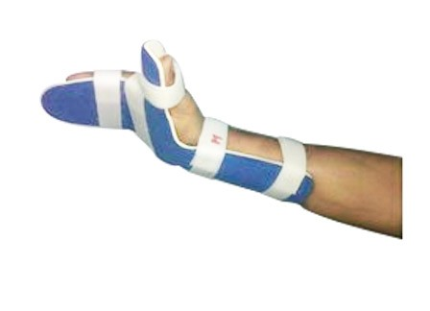
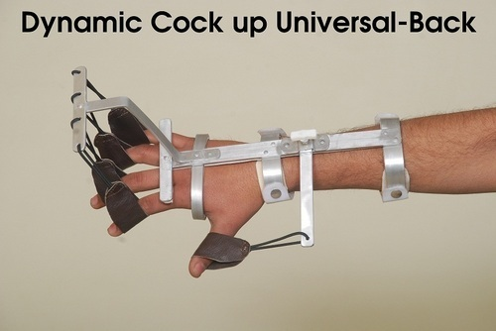
Static splint | Dynamic splint
Cockup with ventral or dorsal support | Cockup splint with extensor out triggers
Robert Jones splint –wrist & fingers in extension | Cockup splint with reverse knuckle bender

Slide 75
Surgical treatment
Restoration of wrist and hand function
Wrist extension
Finger MCP extension
Thumb extension
Stability of carpometacarpal joints of thumb
loss of forearm supination secondary to loss of supinator muscle .
Loss of gross grip strength
Precision pinch is weak

Slide 76
Principle of tendon transfer
One tendon ,one function
Straight line of pull
Similar excursion
Similar strength
Tissue equilibrium
Joint mobility
Expandable donor
Power vs positional motors

Slide 77
Tendon transfer
Muscle | Restoration | Substituting | Action | Positioning | Complication
Pronator teres | Extension of wrist | Loss of ECRL and ECRB | Wrist extension | Rest in 30 of extension against gravity | Tension increases- functional wrist flexion difficult
FCR tendon is splitted | Strong pinch /abduction of 1st MCP | Repower APL –thumb |  | *FCR Radial half of tendon-APL *Palmaris L-EPB
Posterior deltoid | elbow extension | Triceps | Elbow extension
FCU | Finger extension | Long finger extensor | Finger extension

Slide 78
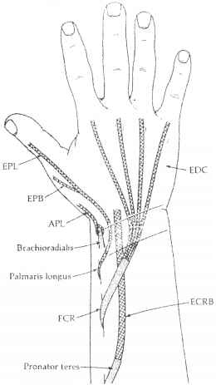
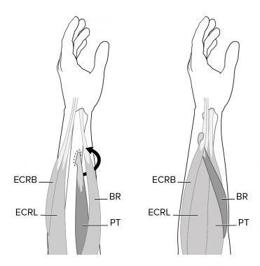

Slide 79
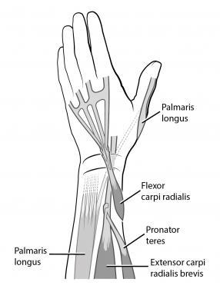
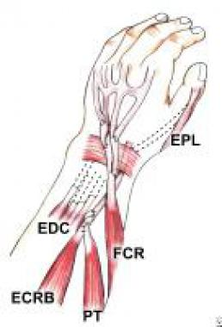

Slide 80
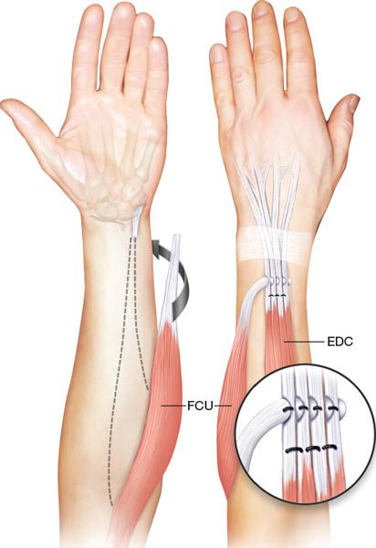
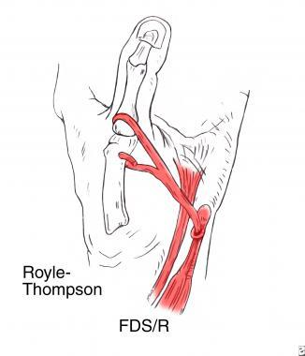

Slide 81
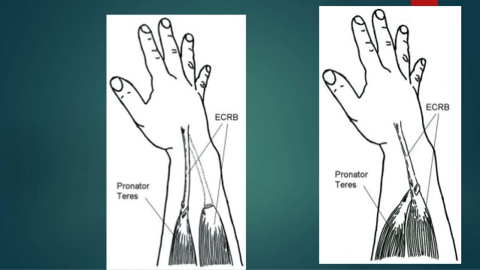

Slide 82
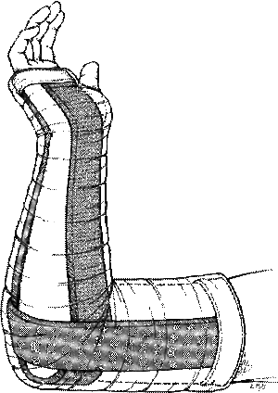
PT intervention
Double sugar tong splint applied to immobilize
Forearm -30 of pronation
Wrist-40 to 45 of extension
MCP-0 of extension
Thumb-maximum extension and abduction
Till 48 hours IP joints are supported then PIP are free
After 5 weeks removed from rigid immobilization –spring action cockup splint –independent action of wrist and finger extension .

Slide 83
Scar mobilization
3 weeks faradic reeducation
inhibition of original action of muscles
Strengthening the needed action
Ex: pronator teres

Slide 84
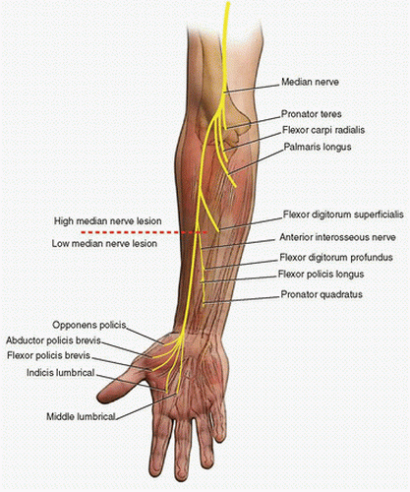
Median nerve
High / low injury
Test for FPL / FDS / FDP
(lat. half) / FCR / Abd.
Pollicis brevis ( pen test) /
Opponens pollicis
See for pointing index /
complete claw hand

Slide 85
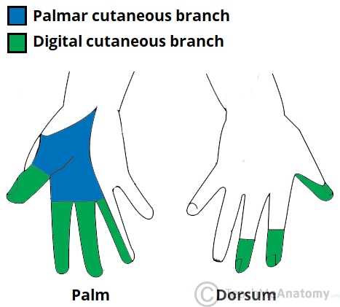
Signs and Symptoms
Sensory
Loss of sensation over volar aspect of lateral 3 ½ fingers up to distal phalanx on dorsal side.
Skin overlying thenar eminence ,pulp of thumb .
Motor
Pronator teres, FCR,FDS,PL,FDP(lateral half), thenar muscles,1st and 2nd lumbricals.

Slide 86
Deformity
Depending upon the site and extent of lesion
Ape hand /Monkey hand (thenar wasting)
Partial claw hand
Pointing index finger
Tip to tip pinch

Slide 87
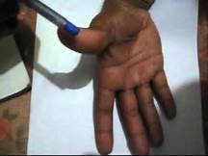
Tests
Pen test
Unable to touch pen due to loss of action of APB.

Slide 88
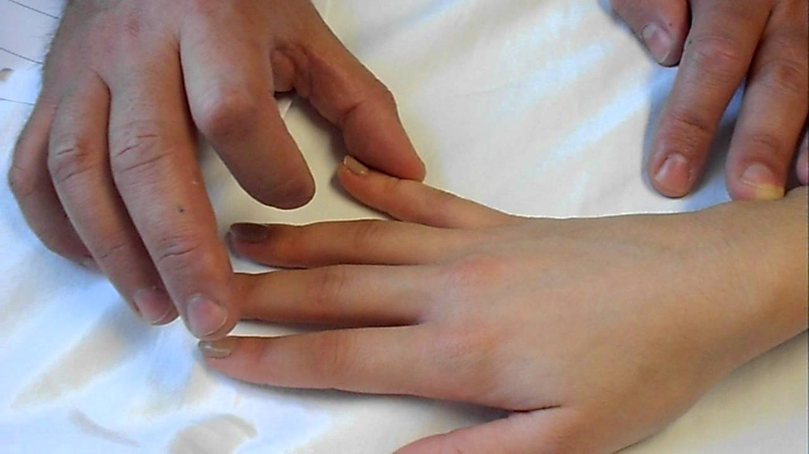
Egawa test
Palm flat on table the patient is asked to move the middle finger sideways (dorsal interossei)

Slide 89
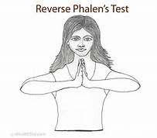
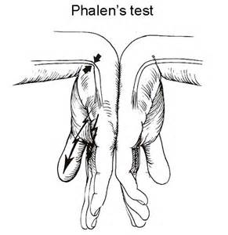

Tinnel’s sign
Tapping along the course of nerve
Phalen’s test
Manually flex wrist and hold for 1 min ,positive indicates pain ,tingling sensation

Slide 90

Compression test
Press for 1 min on median nerve at the distal palmar crease as it enters the CT-pins & needle is positive.
Pointing index/oschner’s clasp test
Clasp both the hands ,index and middle finger fail to flex due to loss of action of long finger flexors of index and middle fingers

Slide 91


Ape hand
Flattening of thenar eminence
Lack of opposition of the thumb
Thumb held with index finger due to over action of AdP & EPL.
Thumb web space contract
Fingers show trophic changes
Slight clawing of index and middle finger

Slide 92

Partial claw hand
Paralysis of first and second lumbricals .
Hyperextension of MCP of index and middle finger along with flexion of IP joints.

Slide 93


Slide 95

Pointing index finger
Higher lesion –long flexors of hand, asking to make a fist the index finger will point forward.
(flx dig.-profundus tendon of ring finger pull middle finger into partial flexion leaving index finger in extension and pointing forward.

Slide 96


Tip to Tip pinch
Anterior interosseous nerve palsy
Index and thumb cannot touch together due to paralysis of FDProfundus & FPL .
Show a tear drop appearance

Slide 97
Functional disability
Difficulty in holding both big and small objects
Activity in involved hand is clumsy.
Trick movements
Paralysis | Action needed | Muscle used | Trick
Pronator teres | Pronation | Brachioradialis | Internal rotation
 | Radial deviation Wrist flexion | ECR FCU
FPL | Flexion of IP | EPL –contraction and relaxation | Rebound
Opponens policies | Opposition | APL-gravity

Slide 98

Thumb rotation is sign of recovery
Treatment
Conservative
Passive movements to wrist & fingers
Gentle stretching of long flexors
IG stimulation to all muscles
Anesthetic hand care
Splints-opposition splints to maintain thumb in opposition.
Prevent contracture of first two webs space.

Slide 99



Two splints used
C-bar splint | Cockup splint
Aluminum orthoplast & POP | Aluminum
Used-maintain first web space held with 3 velcro straps One over index finger One over the thumb One at deepest part of first web space | Opposition out trigger to maintain thumb in opposition

Slide 100
Tendon transfer
Movement | Detaching | Attaching | Position | Treatment
Thumb opposition | FDS of ring finger | APB insertion | Thumb immobilized in opposition 3 weeks | 6 weeks splint –reeducation of transferred tendon
Flx of DIP of thumb | Brachioradialis from insertion | FPL |  | Faradic reeducation started after 3weeks
Flx of index & middle finger | Slitting tendon of FDP of ring & little finger | Middle & index finger | ulnar portion of nerve can pull the fingers to flx
Pronation | Biceps tendon

Slide 101
Ulnar nerve
High / low palsy
Test for FCU / Abd. digiti minimi / Interossei (dorsal - Egawa’s test ; palmar – card test ) / lumbricals /Add.Pollicis (Froment’s sign / book test )
Ulnar claw hand
Bishops hand /benediction hand (hypothenar wasting)

Slide 102
Sensory
Loss of sensation over
hypothenar eminence
The medial 1 ½ finger up to nail beds
Motor loss
Muscles affected are:
FCU
Medial half of flexor digitorum profundus
Hypothenar muscles
AdP
Interossei
Medial two lumbricals

Slide 103

Special test
Froments sign
Tinnels sign
Card test/Froments sign test
Inability to hold a card or paper in between fingers due to loss of adduction by palmar interossei.

Slide 104
Deformity
Claw hand
Joints | Action | Muscles
MCP joint ring finger | Hyperextension | Overaction of ED and EDMinimi
MCP of little finger | Extension 30 degree
IP of two fingers | Flexion
PIP | 25 degree of flexion
DIP | Flexed /extended depending on site of injury
Ulnar nerve injured at wrist
DIP | 10 -15 degree of flexion | overaction of FDP
Ulnar nerve injured at elbow
DIP | Flexion is reduced | Paralysis of Flx digi. profundus

Slide 105


Claw hand

Slide 106
Functional disability
Loss of lumbrical grip
Power grip is affected (lack of hypothenar eminence muscle, wrapping object is difficulty)
Pinch power reduces
Spherical grip is loss due to absence of lateralization of fingers
Lateral pinch is inefficient due to paralyzed AdP

Slide 107
Trick movements
First sign of recovery
AbD minimi is first muscle to recover
Paralysis | Action done | Muscles
Lumbricals | Extension of IP
Dorsal interossei | Abduction | ED
Wrist flexion ask to patient | Radial deviation | FCR

Slide 108



Management
IG stimulation
Passive movements and stretching
care of anesthetic hand
Splintage
Knuckle bender splint
Volar support at MCP
Two dorsal Support on PIP
and metacarpal bones
MCP in flexion
IP in Extension

Slide 109

Surgical management
Tendon transfer
Paul Brands Transfer
ECR is detached from insertion and lengthened by tailed graft of Plantaris muscle.
Then it is slit into 4 moved through lumbericals canal and passes to dorsal aspect and attached to extensor aponeurosis.

Slide 110




Slide 111
Riordans technique
When there is severe clawing of wrist flexion
FCR is detached ,lengthened and inserted as brands surgery (slit into 4-lumbrical canal-dorsal aspect-extensor aponeurosis.
Bunnell's surgery
When there is habitual flexion of wrist
FD of ring finger is slit into 4 tendons and inserted as Brands surgery.

Slide 112
Post operative management
Immobilized in lumbericals grip position by POP -10 days.
Suture is removed and POP-3 weeks.
Cylinder POP applied to all fingers to maintain in extended position-after 3 weeks.
Faradic re-education to active lumbrical grip movement.
2 to 3 weeks POP continued if griping not achieved.
Strengthening exercise started
Paper crumpling/power activities /pegboard exercises.

Slide 113


Slide 114

ERB’s palsy
Upper trunk (upper trunk C5–C6 nerves)
Signs and symptoms
Sensory
Loss of sensation in deltoid insertion
Lateral aspect of forearm and hand
Motor
Muscles paralyzed are deltoid,biceps brachii,brachialis,brachioradialis,supraspinatus,infraspinatus,teres minor.
Weakness of triceps latissimus dorsi, pectoralis major, ECR

Slide 115

Reflexes
Biceps and brachioradialis jerk are affected
Deformity
Policeman's tip/waiter’s tip
Extension ,adduction, internal rotation at shoulder
Extension at elbow
Pronation and flexion at wrist
and fingers.

Slide 116
Functional disability
Flexion movement at shoulder and elbow is lost.
Difficulty in eating,combing,washing,dressing,reaching out
Treatment
IG stimulation
Passive movements and stretching to prevent contracture
Care of edema (depending position of gravity)
Massage to maintain circulation
Splinting

Slide 117


Splinting
To maintain shoulder in functional position
Aeroplane splint
Cheese splint
Both the splints prevents contracture of adductors and internal rotators.
These splints prevents shoulder dislocation.
Strengthening exercise as recovery
starts.

Slide 118

KLUMPKE’S PALSY
Lower trunk( C8-T1)
Sensory
Loss of sensation over medial aspect of forearm , hand and hypothenar eminence.
Motor
Paralysis of all the intrinsic of hand
Wrist
Finger flexors
Topical changes
Dry , scaly, brittle nails

Slide 119

Deformity
Claw hand
Functional deformity
Lack of lumbrical grip
Power grip
Treatment
Stimulation
PROM
Massage
Splintage :Knuckle bender
Strengthening exercise once innervated

Slide 120
Lumbosacral plexus
The lumbosacral plexus terminates in three primary peripheral nerves
These are responsible for innervating the tissues of the lower extremity
• Lumbar plexus – Femoral & obturator nerves
• Sacral plexus – Sciatic nerve

Slide 121

Lumbar plexus

Slide 122


Slide 123


Slide 124


Slide 125


Slide 126
Lower limb palsy
Obturator nerve palsy
Femoral nerve palsy
Common peroneal nerve palsy
Sciatic nerve palsy
Medial popliteal nerve(tibial nerve)palsy

Slide 127

Obturator nerve
Causes
Dislocation of hip joint
Hernia through obturator foramen
Pelvic fracture
Prolonged difficult labor
Compression of the nerve against wall of pelvis by mass tumor or foetus
Disease or injury to sacroiliac or hip joint

Slide 128



Slide 129
Sensory
Loss of sensation over the
Medial aspect of thigh
Medial aspect of knee
Motor
Muscles paralysed are
Anterior division | Posterior division
Adductor longus | Adductor magnus
Adductor brevis | Obturator externus
Gracilis | Adductor brevis
pectineus

Slide 130

Deformity
Adductor muscle paralysis causes, tensor fascia lata overacts and pulls the hip into flexion and abduction deformity.
Treatment
Conservative treatment
PT intervention
IG stimulation of adductor muscles
Strengthening exercise
Re-education once innervated
Stretching of TFL

Slide 131

Femoral nerve
Causes
Psoas abscess
Pelvic neoplasm
Fracture of pelvis
Hip dislocation
Inguinal hernia
Complication of spinal anesthesia
Prolapse IVD
Lumbar spondylosis or stenosis
Neuropathy secondary to DM –diabetic amyotrophy
Penetrating wounds of lower abdomen

Slide 132
Sensory
Loss of sensation
Anterior division-anterior and medial aspect of thigh
Posterior division- continuous as saphenous nerve –medial aspect of leg and foot up to great toe.
Autonomous zone
Superior and medial to patella
Reflexes
Quads jerk lost

Slide 133
Motor
Muscles paralyzed are
Deformity
Genu Recurvatum –quads paralyzed
Lock the knee into hyperextension to get COG in front of knee joint for stability.
Anterior division | Posterior division
Sartorius | Vastus medialis
pectineus | Rectus femoris
 | Vastus intermedius
 | Vastus lateralis

Slide 134



Treatment
IG stimulation
Passive movements/AAROM
Orthosis to correct recurvatum
Knee guard
Knee ankle orthosis

Slide 135

Sciatic nerve palsy

Slide 136

Sciatic nerve
Common peroneal nerve
Superficial peroneal nerve (lateral aspect)
Deep peroneal nerve (great toe-medial )
Tibial nerve (posterior)
Lateral plantar nerve
Medial plantar nerve

Slide 137
Causes
Penetrating wounds around the pelvis
Fractures of pelvis and femur
Dislocation of hip joint
Intramuscular injection in gluteal region
Compression due to neoplasm or foetal head
Entrapment or compression by piriformis muscle in sciatic notch

Slide 138
Sensory
Complete loss of sensation below knee
Autonomous zone
Heel
The skin over metatarsal head in sole ,dorsum of feet
Motor
Biceps femoris
Semitendinosus
Semimembranosus
Hamstring part of adductor magnus
All branches of tibial and common peroneal nerve will be paralyzed

Slide 139


Deformity
Flail leg with foot drop
Clawing of toes with trophic ulceration

Slide 140



Treatment
IG stimulation
PROM
TA stretching
Splintage –night splint
L splint to prevent foot drop & contracture of plantar flexors
Below knee caliper –AFO
Padded footwear /microcellular rubber footwear
Metatarsal bar to foot wear to prevent metatarsal drop
Care of anesthetic foot

Slide 141

Common peroneal nerve palsy
Causes
Compression of nerve by tight plaster or splint
Fracture of neck of fibula
Fracture dislocation of head of fibula
Hansen's disease or leprosy
Trauma to knee
Entrapped ,compressed or irritated nerve by fibrous arch around neck of fibula.
Prolonged immobilization-external rotation

Slide 142
Sensory
Loss of sensation
Lateral aspect of knee in proximal third of calf (lateral cutaneous sural nerve)
Posterolateral aspect of calf-lateral malleolus,4th & 5th toes
It is dived into
Deep peroneal | Superficial peroneal
Web space between great toe and second toe | Anterior and lateral aspect of leg
Lateral aspect of dorsum of great toe | Dorsum of foot and toes
Medial aspect of dorsum of second toe

Slide 143


Slide 144

Motor
Paralysis of these muscles
Deformity
Equinovarus deformity (foot drop) due to over action of posterior compartment muscles
Superficial | Deep
PL | TA
PB | EHL
 | EDL
 | EDB
 | Peroneus tertius

Slide 145


Treatment
IG stimulation
PROM
Stretching tendoachilles
Splints and orthosis
Ankle in neutral position prevent equinus –caliper with dorsiflexion
Plastic AFO in form of shoes

Slide 146

Medial popliteal nerve (tibial nerve)
Causes
Injection palsy
Deep penetrating injury to knee
Dislocation of knee
Tarsal tunnel syndrome –entrapped between luncinate ligament and medial surface of talus distal to medial malleolus.

Slide 147
Sensory
Loss of sensation
Sole of the foot
Skin over medial aspect of heel
Motor
Paralyzed muscles are
Gastrocnemius , plantaris, soleus,FHL,FDL,TP and popliteus.
Reflexes
Ankle jerk is lost

Slide 148


Deformity
TEV
Dorsiflexion deformity
Talipes calcaneovalgus deformity

Slide 149

Treatment
IG stimulation
PROM
Stretching
Care of anesthetic foot
Orthosis: below knee caliper with dorsiflexion
Surgical
Transfer of TA & EHL to first metatarsal to prevent drop
Evertors transfer –arthrodesis of subtalar and transverse tarsal joint
Triple arthrodesis

Slide 150
References
Randall L Braddom
Physiotherapy In Paediatrics by Roberta shepherd.
Michel le.H Cameron.
Darcy A Umphred

Slide 151
Thank you

